Slide 1


Slide 2
What to expect?
JS Background.
How it all started (History).
What is NODE.js
How it works.
The architecture.
REPL (Read-Eval-Print-Loop)
Global Object.
Modules.
Q&A

Slide 3
Background
Browsers.
HTML + CSS
JS - for Dynamic web pages
JS is Client side scripting language*.
Q: Oh is it? then what about Servers side programing languages?
A: Java, PHP, ASP.net, Python…
Q: Then what is node?
A: It is not a language, neither a JS-framework like React/Angular/Vue.
Note: JS is no more just client side scripting language, since 2009 because of node.js

Slide 4
Then what is node.js? How it all started?

Slide 5
What is node.js?
Node.js is Open Source
Created by Ryan Dahl in 2009
Current version v10.16.0(LTS)
Node.js is built on Chrome’s v8 engine.

Slide 6
What is node.js?
is for JavaScript running on the server.
is Single Threaded.
is Asynchronous.
is event driven and non Blocking.
is V8+APIs+EventQ+EventLoop
https://www.youtube.com/watch?v=jOupHNvDIq8

Slide 7
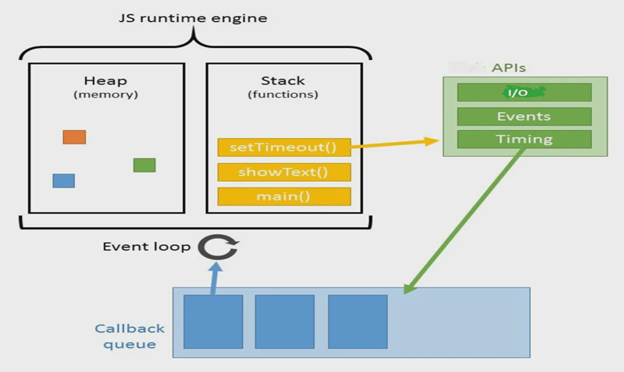
The Architecture

Slide 8
Globals in NODE.js
global
console
process
Buffer
setTimeout
clearTimeout
setInterval
clearInterval
setImmediate
clearImmediate
NOTE: exports, require, module, __dirname, __filename are not global.

Slide 9
Modules system in Node.js
Every file in a node.js is a module.
Node wraps every file code within a function called Module wrapper function.
It passes 5 params to each module.
exports, require, module, __filename, __dirname
Variables declared are local to the module/file.
Use module.exports to expose a variable/function from the module.
Use require to import from other modules

Slide 10
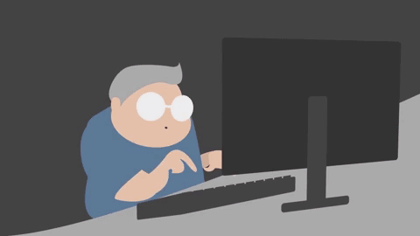
Node in action: lets code

Slide 11
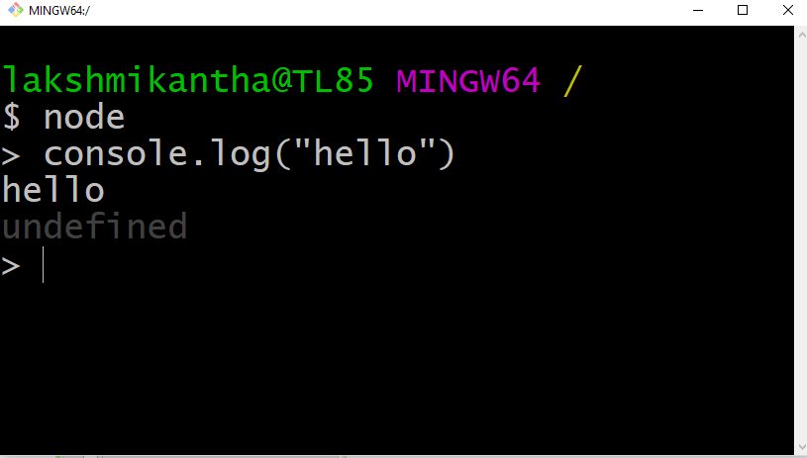
REPL
read eval print loop

Slide 12
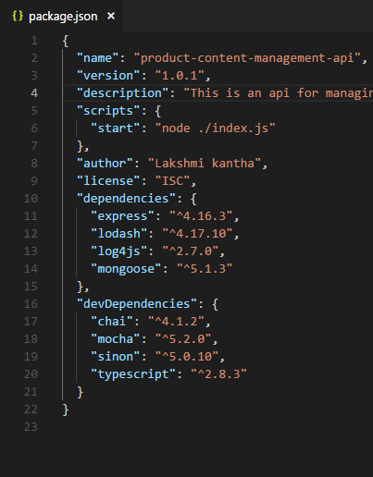
NPM
Node package manager
Bundled with node.
Package.json
Command : npm init

Slide 13
What can we build with node.js?
Rest APIs & Backed Applications
Real-Time Services (Chat, Games .etc)
Blogs, CMS, Social applications.
Utilities and Tools.
So Build anything that is not CPU intensive.

Slide 14
Q&A
THANK YOU

